Slide 1
AI -DRIVEN EXPLORATION AND PREDICTION OF COMPANY REGISTRATION TRENDS WITH REGISTER OF COMPANYS. DEVELOPMENT PART-2

Slide 2
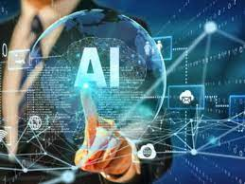
AI DEVELOPMENT PART
Total’s AI development services help businesses improve their decision making and automate business operations and workflows. Top companies and startups work with Total AI developers to augment their in-house development teams and build AI applications, software solutions, and machine learning algorithms that solve business problems in areas including customer experience and supply chain.

Slide 3
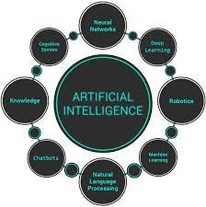
TRENDS IN COMPANY MARKETING
Artificial Intelligence(AI), is rightfully among the technologies that are fundamentally changing the modern world.
Expectations from AI developments are confirmed by a willingness to invest in them. The Stanford Artificial Intelligence Index Report 2022, reveals that private investment in artificial intelligence is growing rapidly, reaching an amount of about 93.5 billion US dollars in 2021, more than double the corresponding figure in 2020.

Slide 4
AI Unlocks the Metaverse
3D models of which objects and systems will be primarily useful for companies and their consumers.
Processes involving clients and partners that can be painlessly transferred to the virtual world, and perhaps even made better there. Nowadays, no one is surprised by virtual fitting or product testing, digital modeling of decor, and much more.
Priorities, preferences, and expectations of your target audience in the Metaverse, which becomes a space for communication, sales, and other forms of interaction.

Slide 5
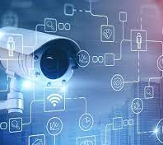
AI Enhances Security and Surveillance
Identifying a person, including their age, gender, and emotional state, through voice recognition has also become an important feature of AI-powered applications. A built-in anti-spoofing feature that detects synthesized and recorded voice is just what is needed to keep such tools safe. Biometric facial recognition is also essential for maintaining security.

Slide 6
PROGRAM
import edu . stanford .nlp .ling.CoreAnnotations;
import edu.stanford.nlp.neural.rnn.RNNCoreAnnotations;
import edu.stanford.nlp.pipeline.Annotation;
import edu.stanford.nlp.pipeline.StanfordCoreNLP;
import edu.stanford.nlp.sentiment.SentimentCoreAnnotations;
import edu.stanford.nlp.trees.Tree;
import edu.stanford.nlp.util.CoreMap;
import java.util.Properties;.

Slide 7
Public class Sentiment Analysis Example { public static void main(String[] args) { // Set up the Stanford NLP pipeline Properties props = new Properties(); props.set Property("annotators", "tokenize, ssplit, parse, sentiment"); StanfordCoreNLP pipeline = new StanfordCoreNLP(props); // Analyze the sentiment of a text String text = "I love this product! It's amazing."; Annotation annotation = new Annotation(text); pipeline.annotate(annotation); // Get the sentiment score for (CoreMap sentence : annotation.get(CoreAnnotations.SentencesAnnotation.class))

Slide 8
{ Tree tree = sentence.get(SentimentCoreAnnotations.SentimentAnnotatedTree.class); int sentiment = RNNCoreAnnotations.getPredictedClass(tree); System.out.println("Sentiment: " + sentiment); } } }

Slide 9
GOALS OF AI DEVELOPMENT
Problem-Solving and Decision Making
Natural Language Processing (NLP)
Machine Learning and Deep Learning
Robotics and Automation
Enhancing Healthcare and Medicine
Fostering Creativity and Innovation

Slide 10
THANK YOU SUBMITTED BY, R.BHAVADHARANI III- MEDICAL ELECTRONICS

